Slide 1
FSMs and Multiplication
CS 0447
Jarrett Billingsley

Slide 2
Class announcements
didja see the announcement re: project 1?

Slide 3
States and Transitions

Slide 4
Characterizing the blinky
state is all the things that are remembered by a system. (hardware or software!)
the blinky can be in two states: on or off.
when the clock ticks, what happens to the state?
if it was off, it turns on.
off
on
D
Q
if it was on, it turns off.
this is a state transition diagram.
Notes:
state in programming is all your globals, objects, arrays etc. that are in use at any given time.
if you use emulators and are familiar with “save states”… that’s what they are. they’re a copy of all the state of the entire system

Slide 5
More states
what states can a ceiling fan be in?
high, medium, low, and off
what says, "go to the next step/state?"
pulling the chain!
pull
pull
pull
off
high
med
low
pull
how many bits of state are needed now?
Notes:
- essentially the chain is the clock for this circuit. it says when to move to the next step.
- we need two bits!
they start on high to give the motor the best possible chance to start, because single-phase induction motors are a bit weird and if they don't have enough oomph to start they'll just sit there and hum and burn themselves out
there’s a Technology Connections video about this, cause of course there is

Slide 6
Automatic Caution Door
consider an automatic swinging door. it has an input: a pad.
when someone steps on the pad, it opens.
opening
closed
open
when no one is stepping on the pad, it closes.
closing
it also has to know when to stop moving, so…
there are really three inputs: the pad, the open sensor, and the closed sensor.
Notes:
- this is a pretty simplified model; real doors have two pads, a timer, other sensors, modes to stay open/closed, etc.

Slide 7
More abstractly…
for each transition, we write the inputs that cause it to happen.
open_sensor=0
we should also make transitions for when to stay in a state.
pad=1
opening
open_sensor=1
closed
open
pad=0
pad=1
pad=1
closing
pad=0
closed_sensor=1
but we can make it smarter, too. what if someone steps on the pad while it's closing?
closed_sensor=0
AND pad=0

Slide 8
It's getting cluttered
a state transition table is the sequential version of a truth table.
it encodes the same information as a state transition diagram.
off
high
med
low
this input column says "the state at time n."
the output is the next state: the state at time n+1.
S_{n} | S_{n+1}
off | high
high | med
med | low
low | off
each arrow becomes one row in the table: S_{n} is the "from" and S_{n+1} is the "to."
of course, this machine has no inputs (other than the pull-chain), so…

Slide 9
The door controller (animated)
this is gonna be a bigger table. 3 inputs, 4 states, 9 arrows…
open_sensor=0
S_{n} | pad | OS | CS | S_{n+1}
pad=1
opening
open_sensor=1
closed
0
closed
closed
1
opening
closed
open
opening
0
opening
pad=0
pad=1
pad=1
opening
1
open
closing
open
1
open
pad=0
closed_sensor=1
open
0
closing
closing
0
0
closing
closed_sensor=0
AND pad=0
closing
1
opening
closing
1
closed

Slide 10
idc
we've got a bunch of empty inputs.
what do we put in there?
one way of shortening a big truth or transition table is to use X's.
S_{n} | pad | OS | CS | S_{n+1}
closed | 0 |  |  | closed
closed | 1 |  |  | opening
opening |  | 0 |  | opening
opening |  | 1 |  | open
open | 1 |  |  | open
open | 0 |  |  | closing
closing | 0 |  | 0 | closing
closing | 1 |  |  | opening
closing |  |  | 1 | closed
X
X
X
X
X is a don't-care. it means "0 or 1."
X
X
X
X
X
X
think about it… with 4 states and 3 inputs, that would be 32 rows, but we got it down to 9!
X
X
X
X
X
X
X
there's some weirdness down here in the "closing" state but let's just handwave that away
Notes:
- for example, the first row is shorthand for 000, 001, 010, and 011.
- the weirdness is that there's some overlap in the last two rows; e.g. both would "match" 1 0 1
- really the second to last row should be "closing 1 x 0 | opening" but
- we're kinda assuming that it's impossible for the pad AND the closed sensor to both be 1 in the closing state
- it's just an example okay! don't worry about it!

Slide 11
Finite State Machines (FSMs)

Slide 12
What's a Finite State Machine (FSM)?
an FSM is a way of thinking about a sequential process where:
there is state (memory)
the state changes based on the current state, transition logic, and (optionally) inputs
there are outputs based on the state
(and maybe on the inputs, too)
outputs
inputs
D
Q
transition logic
output logic
state memory
Notes:
- this is a sort of pseudo-schematic view but it often does look like this

Slide 13
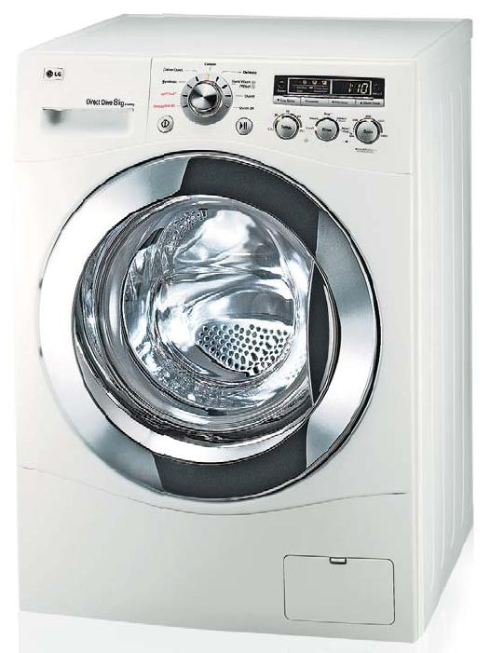
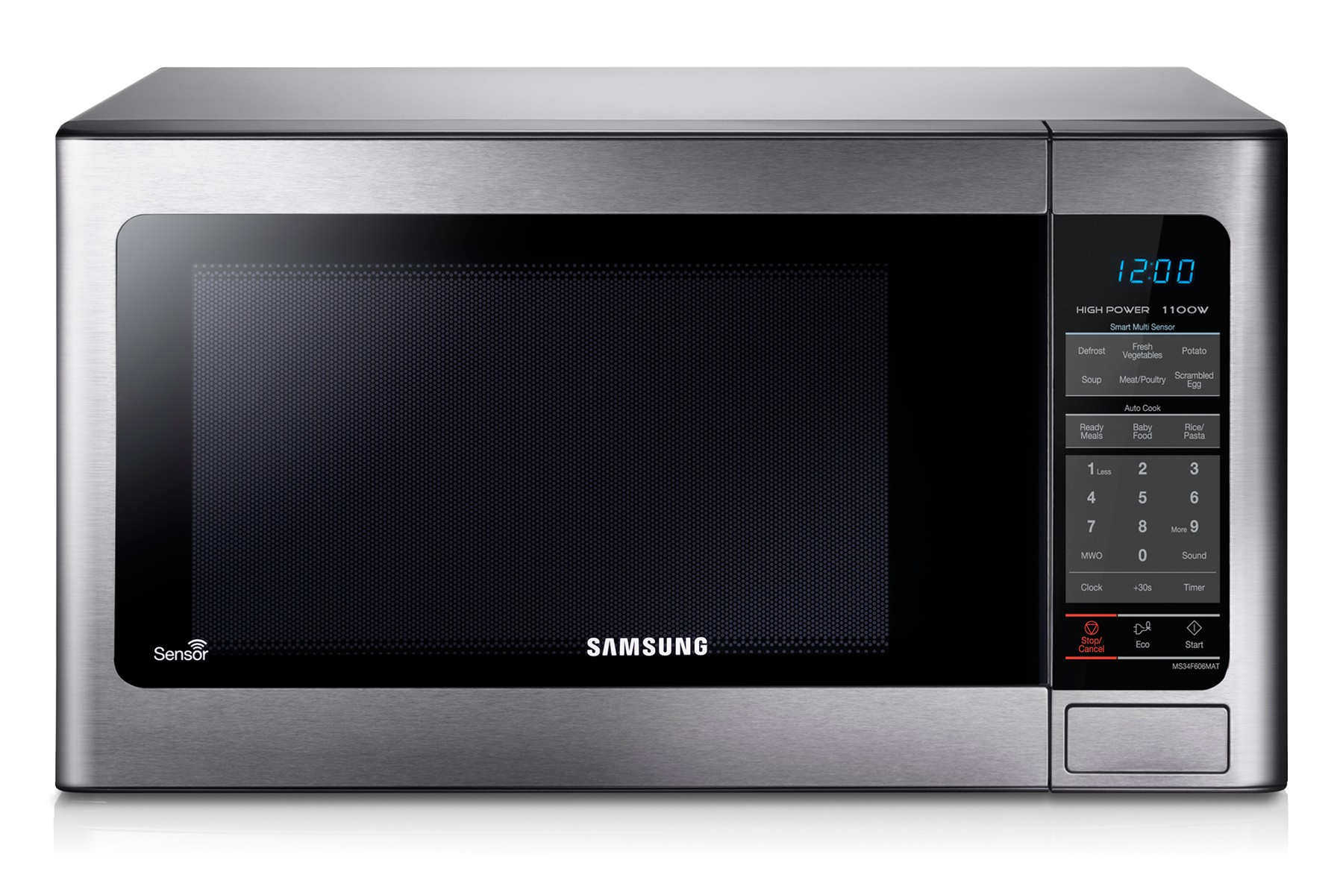
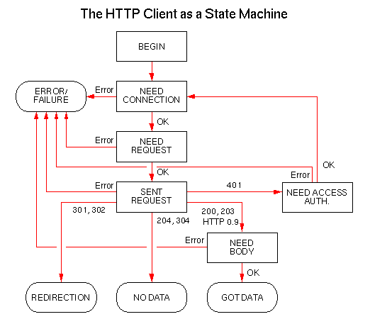
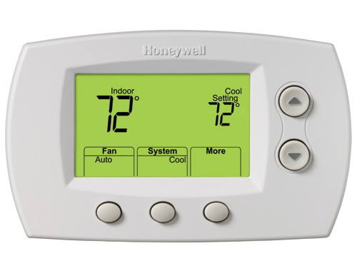
A repeating pattern
many hardware and software problems can be thought of as FSMs
they're used for parsing: code, file formats, network protocols, etc.
FSMs are used for all sorts of control tasks: appliances, HVAC, infrastructure, etc.
for(int i = 0; i < 10; i++) { ... }
Notes:
- HVAC = heating, ventilation, air conditioning
- before we had cheap microcontrollers, lots of devices used FSMs made of discrete components to control them
- think vending machines, traffic lights, automatic doors…
- and before THAT, we used mechanical FSMs
- some things still do… you know that weird crunchy-sounding knob on your washing machine? yep.
- mechanical thermostats, mechanical alarm clocks, sewing machines, looms, jukeboxes, etc.

Slide 14
Yo dawg I heard you like FSMs
when you're designing a complex system with state...
breaking it into smaller FSMs can be a useful design technique
maybe you're making a game…
Explosion_timer=1
Explosion_frame=3
Object_x=0x3402
Object_y=0x07F0
setup
and each object is an FSM
play
Bullet_frame=4
Bullet_frame=17
win
lose
player_accel=0
and every frame they look at inputs, change state, and produce some output
and the whole program is an FSM
Notes:
- well you didn't make something quite this complex but it was still FSMs-in-FSMs!

Slide 15
The big picture
the overall architecture of any computer looks like this:
Inputs
Outputs
Control
Memory
ALU
Registers
Transition Logic
State

Slide 16
There are lots of states
your whole computer is an FSM :^)
with 4GB RAM, 32 32-bit registers, plus some more registers in there, and all the input/output devices have memory and regs…
we're talking somewhere on the order of uhhhhh
2¹³⁷⁴³⁸⁹⁵⁴⁴⁹⁶ states
that is, 2 to the "number of bits of storage" states.
it's a finite number of states but it's so ridiculously huge that it's practically infinite
Notes:
- the number of states is 2 raised to the number of bits of storage.
- so, it adds up really, really fast.

Slide 17
What's the limit?
well... theoretically speaking, they're limited.
there are some problems that cannot be solved with a finite number of states.
they are not Turing-complete in the strictest sense.
but in reality, nothing is infinite, so…
for all practical purposes, they can do anything.
put enough of them together, and you get a computer.
or a universe. maybe.
I'm summing up a lot of CS 1502 in a few lines, so… spoilers!
Notes:
matter and energy are quantized into finite states; but we don't know if the universe itself is infinite, or if space and time are quantized, and we don't really understand the underlying logic of the state transitions except probabilistically… are hidden variable theories real? bell’s inequality??!??! idk lol

Slide 18
Multiplication time check: ≤45 min

Slide 19
Multiplication by repeated addition
in A × B, the product (answer) is "A copies of B, added together"
6 × 3 =
18
1 | 2 | 3
4 | 5 | 6
7 | 8 | 9
10 | 11 | 12
13 | 14 | 15
16 | 17 | 18
with this naïve method, how many additions would it take to calculate
500,000,000 × 2?

Slide 20
Back to grade school
remember your multiplication tables?
binary is so much easier
if we list 0 too, the product logic looks awfully familiar…
✕ | 1 | 2 | 3 | 4 | 5 | 6 | 7 | 8 | 9
1 | 1 | 2 | 3 | 4 | 5 | 6 | 7 | 8 | 9
2 | 2 | 4 | 6 | 8 | 10 | 12 | 14 | 16 | 18
3 | 3 | 6 | 9 | 12 | 15 | 18 | 21 | 24 | 27
4 | 4 | 8 | 12 | 16 | 20 | 24 | 28 | 32 | 36
5 | 5 | 10 | 15 | 20 | 25 | 30 | 35 | 40 | 45
6 | 6 | 12 | 18 | 24 | 30 | 36 | 42 | 48 | 54
7 | 7 | 14 | 21 | 28 | 35 | 42 | 49 | 56 | 63
8 | 8 | 16 | 24 | 32 | 40 | 48 | 56 | 64 | 72
9 | 9 | 18 | 27 | 36 | 45 | 54 | 63 | 72 | 81
✕ | 1
1 | 1
A | B | P
0 | 0 | 0
0 | 1 | 0
1 | 0 | 0
1 | 1 | 1
Notes:
- it's an AND! (hey, we don't call it "logical product" for nothing.)

Slide 21
Just like you remember
you know how to multiply, riiiight?
1011 =
× 0101 =
1011
0000
1011
0000
11
× 5
Multiplicand
Multiplier
these are the partial products. how many two-number additions are we doing?
55
0
00
000
wait, what operation are we doing here...?
so that means… multiplication is always slower than addition.
110111
Notes:
- for an n-bit multiplier, we have n partial products, and therefore n-1 (or O(n)) additions.
- each partial product is shifted left one more place than the one above it.
- you do this in decimal too! each row of the partial product is multiplied by 10 (shifted left one place).

Slide 22
Wait, why does this work?
what are we actually doing with this technique?
remember how positional numbers are really like polynomials?
FOIL…
78×54
= 70×50 + 70×4 + 8×50 + 8×4
= 7×5×100 + 7×4×10 + 8×5×10 + 8×4
we're eliminating many addition steps by grouping them together by powers of the base.
on paper, the partial products kind of "squish" these terms together, but the idea is the same.
but this is addition. do we have to do it in a particular order?
no… so keep that in mind ;)

Slide 23
How many bits?
when we added two n-digit/bit numbers, how many digits/bits was the sum?
how about for multiplication?
when you multiply two n-digit/bit numbers, the product will be at most 2n digits/bits
so if we multiply two 32-bit numbers…
we could get a 64-bit result! AAAA!
if we just ignored those extra 32 bits, or crashed, we'd be losing a lot of info.
so, we kinda have to store it.
99
× 99
9801
9999
× 9999
99980001
1111
× 1111
11100001
Notes:
- when adding two n-bit numbers, we could get an n+1-bit result.
- technically if you multiply an m-bit number by an n-bit result then the product can be (m+n) bits, but if m = n (commonly), then it's 2n.

Slide 24
How (and why) MIPS does it
MIPS has two more 32-bit registers, HI and LO. if you do this:
mult t0, a0
then HI = upper 32 bits of the product and LO = lower 32 bits
to actually get the product, we use these:
mfhi t0 # move From HI (t0 = HI)
mflo t1 # move From LO (t1 = LO)
MIPS does this for 2 reasons:
multiplication takes longer than addition
we'd otherwise have to change two different registers at once
which no other instruction does… well except for division ;O
different architectures solve this problem in different ways!
Notes:
in like, MIPS version 1.1 they did add a 3-operand "mul" instruction because it's so common
in x86, it hard-wires the “dx” and “ax” registers to hold the upper and lower bits of the product respectively.
e.g. 32-bit x86 puts the result in edx:eax; 64-bit x86 puts the result in rdx:rax
in ARMv7 and earlier, the “long” multiply instructions take two explicit registers as the destination of 32x32-bit multiplications.
in ARMv8/AArch64, if you want the upper 64 bits of the 128-bit product, you have to do it as a separate instruction.

Slide 25
What works on paper isn’t always the best way…
let's look at how we learned to do it on paper.
78
×
but we could go left-to-right and get the same answer.
5
4
but what do you know about the order of addition?
our algorithm does this:
312
(((8×4) + 70×4) + 8×50) + 70×50
3900
addition is commutative and associative.
4212
(8×4 + 70×4) + (8×50 + 70×50)
what if we had eight people working on the same 8-digit by 8-digit multiplication?
Notes:
- we could assign one digit of the multiplier to each person to get 8 partial products
- then each pair of people could add their results to get 4 intermediates
- and then have 2 pairs of those add their results to get 2 intermediates
- and then add those 2 intermediates to get a final result.

Slide 26
The shape of an algorithm
there are two key insights into how multiplication works that we can use to come up with a fast algorithm for it:
1. the partial products don’t depend on each other.
PP₁
PP₂
PP₃
PP₄
PP₅
PP₆
PP₇
PP₈
+
+
+
+
2. the order of additions does not matter; but you do have to do n-1 of them.
+
+
+
and if we draw arrows showing the flow of data from each step to the next…
this is basically a circuit diagram already! yeah, it’s missing some details, but they’re not complicated. see fast_mult_4x4.circ!
Notes:
this shape is a binary tree, and it comes up a lot in data structure and algorithm design.
when you see it, you should think “log base 2,” and when you see “log base 2,” you should think of this shape.

Slide 27
Pros and Cons
this algorithm takes a logarithmic number of steps, based on the number of bits n in the input.
that means if you double n, you only add one more step!
however, for n bits, it requires (n - 1) n-bit adders.
and remember that each n-bit adder is n 1-bit adders stacked up.
therefore, it requires approximately n² 1-bit adders!
so if you double n, you quadruple the number of 1-bit adders!
this is a space-time tradeoff: it completes quickly, at the cost of having to use a lot of space (circuitry) to do it.
well, maybe FSMs can give us another approach…
Notes:
- in big-O notation, we say it’s O(log n) time, but O(n²) space, where n = number of bits.

